Slide 1
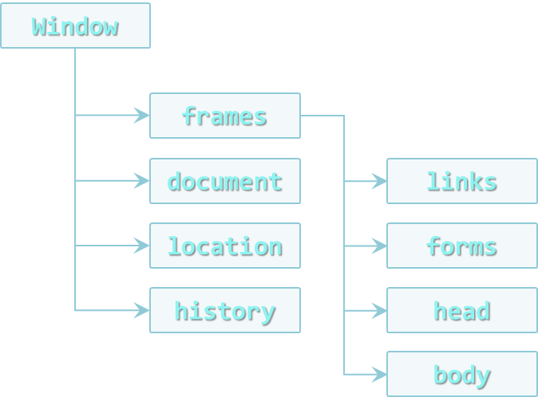

DOM Operations
Creating Dynamic Pages
Telerik Software Academy
Learning & Development Team
http://academy.telerik.com

Slide 2
Table of Contents
Traversing the DOM
Parents, Children and Siblings
DOM manipulation
Adding, Removing and Altering Elements
Static and Live NodeLists

Slide 3
DOM Elements

Slide 4
DOM Elements
DOM element is a JavaScript object that represents an element from the HTML
Selected using any of the DOM selectors
Created dynamically from code
DOM elements can be changed
This changes are immediately applied to the DOM, and the HTML page
//changes the content of the div
selectedDiv.innerHTML = "changed";
//changes the background of the div to "#456"
selectedDiv.style.background = "#456";
var div = document.createElement("div");

Slide 5
Homework
Write a script that creates a number of div elements. Each div element must have the following
Random width and height between 20px and 100px
Random background color
Random font color
Random position on the screen (position:absolute)
A strong element with text "div" inside the div
Random border radius
Random border color
Random border width between 1px and 20px

Slide 6
Homework (2)
Write a script that creates 5 div elements and moves them in circular path with interval of 100 milliseconds
Create a text area and two inputs with type="color"
Make the font color of the text area as the value of the first color input
Make the background color of the text area as the value of the second input

Slide 7
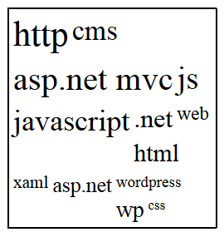
Homework (3)
Create a tag cloud:
Visualize a string of tags (strings) in a given container
By given minFontSize and maxFontSize, generate the tags with different font-size, depending on the number of occurrences
var tags = ["cms", "javascript", "js", "ASP.NET MVC", ".net", ".net", "css", "wordpress", "xaml", "js", "http", "web", "asp.net", "asp.net MVC", "ASP.NET MVC", "wp", "javascript", "js", "cms", "html", "javascript", "http", "http", "CMS"]
var tagCloud = generateTagCloud(tags,17,42);

Slide 8
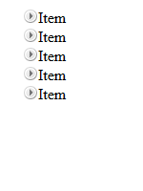
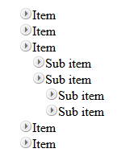
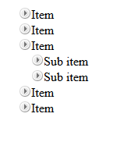
Homework (4)
*Create a TreeView component
Initially only the top items must be visible
On item click
If its children are hidden (collapsed), they must be made visible (expanded)
If its children are visible (expanded), they must be made hidden (collapsed)
Research about events
Initial
Sub item expanded
Top level expanded

